Slide 1




Sarcasm Detection on Twitter
A Behavioral Modeling Approach
Ashwin Rajadesingan, Reza Zafarani, and Huan Liu
Notes:
The best way to pull your advisor’s legs is to let your advisor present the work

Slide 2

Sarcasm
a nuanced form of language where usually, the user explicitly states the opposite of what she implies.

Slide 3
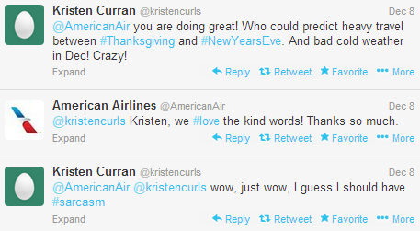
Why Detect Sarcasm?
Most large companies have dedicated social media teams providing real-time assistance to consumers.
These teams use social media tools such as Salesforce’s Social Hub to manage the high volume, high velocity tweets.
One Reason is to Avoid PR Blunders

Slide 4
Related Work
Authors | Conference | Overview of methodology
Riloff et al. | EMNLP 2013 | Lexicon-based approach contrasting positive sentiment and negative situation
Liebrecht et al. | WASSA (ACL 2013 workshop) | Unigram, bigram and trigram features used to train a Balanced Winnow classifier
Reyes et al. | DKE 2012 | Ambiguity, emotional cues etc., to train decision trees
Gonzalez-Ibanez et al. | ACL 2011 | lexical and pragmatic features to train SMO classifier
Davidov et al. Tsur et al. | CoNLL 2010 ICWSM 2010 | Patterns and punctuations based features used in a weighted k-nearest neighbor classifier
Viewing sarcasm from a linguistic perspective
Notes:
SMO – sequential minimal optimization

Slide 5
Some Characteristics of Twitter
Fewer word cues (140 character limit)
Evolving slang words, abbreviations, etc.
However, Twitter provides
  Past tweets
  Profile information
  Social graph

Slide 6
Problem Definition
Given an unlabeled tweet t from user u along with a set of u's past tweets T, a solution to sarcasm detection aims to automatically detect if t is sarcastic or not.

Slide 7
SCUBA
( Sarcasm Classification using a Behavioral modeling Approach )
SCUBA learns from findings of behavioral and psychological aspects of sarcasm to determine if a tweet is sarcastic
SCUBA captures these behavioral patterns in users’ past tweets and profiles to complement the (relatively little) information available in tweets
SCUBA constructs computational features to train a supervised model to detect sarcastic tweets

Slide 8

1. Sarcasm as a Contrast of Sentiment (Grice, 1975)
a. Contrasting Connotations
Using words with contrasting connotations within the same tweet.
Difference between the maximum positive and negative sentiment/affect words present as features.
b. Contrasting Present with Past

Slide 9
2. Sarcasm as a Complex form of Expression (Rockwell, 2007)
Readability
Features inspired from tests measuring readability of text
Measures | Readability Test
Number of words and syllables | Flesch-Kincaid Grade Level Formula
Number of polysyllables | SMOG test
Average word length | Automated Readability Index

Slide 10
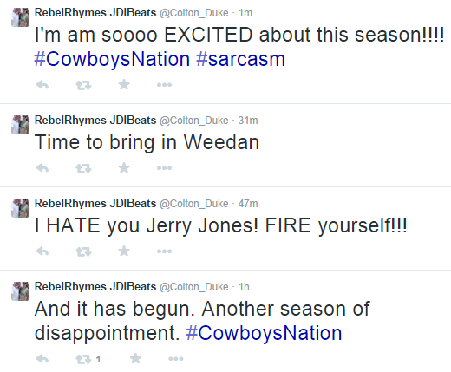
3. Sarcasm as a Means for
Conveying Emotion
(Basavanna, 2000), (Toplak, 2000), (Ducharme, 1994), (Grice, 1978)
Mood: A user in a foul mood is more likely to use sarcasm
Emotional expressiveness:
how expressive a Twitter
user is based on past
sentiment usage
Frustration: People use sarcasm to vent out
frustration (Ducharme, 1994)
  - number of swear words

Slide 11
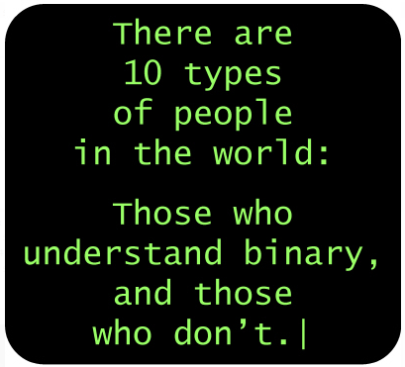

4. Sarcasm as a Function of Familiarity
(Cheang, 2011; Rockwell,2003, 2011)
a. Familiarity of environment
People express sarcasm better when they are well acquainted with the environment. We can model it with features such as:
      Number of tweets posted in Twitter
      Number of friends and followers
      Frequency of Twitter usage
b. Familiarity of language (Dress, 2008)
  Measured with vocabulary/grammar skills
    We measure vocabulary and POS usage in Tweets

Slide 12
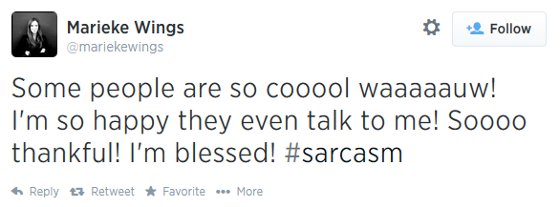

5. Sarcasm as a Form of Written Expression
Sarcasm in speech includes low pitch, high intensity and a slow tempo (Rockwell, 2000). Written sarcasm is devoid of such options.
Prosodic variations
Structural variations: Structural variations are inadvertent variations in the POS composition of tweets to express sarcasm.
Notes:
Part of Speech

Slide 13
Research Questions
Does our behavior modeling approach work? How well?
Does using historical information actually benefit sarcasm detection?
  If so, how much historical information is required?
Which features from theories contribute most to sarcasm detection on Twitter?
Notes:
Work means it performs better than current approaches

Slide 14


Dataset
Sarcastic tweets:
  9,104 tweets containing #sarcasm and #not
Other tweets:
  81,936 random sample of tweets
    (after removing tweets containing #sarcasm and #not)
Dataset: http://bit.ly/SarcasmDetectionWSDM2015

Slide 15
Baselines
Contrast Approach - tweet is sarcastic if it contains a positive verb phrase or positive predicative expression and a negative situation phrase (Riloff et al., EMNLP 2013)
Hybrid Approach - Contrast Approach + n-gram model (Riloff et al., EMNLP 2013)
Embedded results from the n-gram model into SCUBA as well. We call the n-gram augmented framework, SCUBA++

Slide 16
Baseline Algorithms
SCUBA – {past sarcasm hashtags feature}
Majority classifier
N-gram model used in Hybrid Approach and SCUBA++
Notes:
SCUBA++ - our n-gram augmented framework

Slide 17
Performance Comparison
10-Fold Cross Validation
Technique | Dataset Distribution
 | 1:1 |  | 20:80 |  | 10:90
 | Accuracy | AUC | Accuracy | AUC | Accuracy | AUC
SCUBA++ | 86.08 | 0.86 | 89.81 | 0.80 | 92.94 | 0.70
SCUBA | 83.46 | 0.83 | 88.10 | 0.76 | 92.24 | 0.60
SCUBA - #sarcasm | 83.41 | 0.83 | 87.53 | 0.74 | 91.87 | 0.63
Baseline: Contrast Approach | 56.50 | 0.56 | 78.98 | 0.57 | 86.59 | 0.57
Baseline: Hybrid Approach | 77.26 | 0.77 | 78.40 | 0.75 | 83.87 | 0.67
Baseline: N-gram Classifier | 78.56 | 0.78 | 81.63 | 0.76 | 87.89 | 0.65
Baseline: Majority Classifier | 50.00 | 0.50 | 80.00 | 0.50 | 90.00 | 0.50

Slide 18
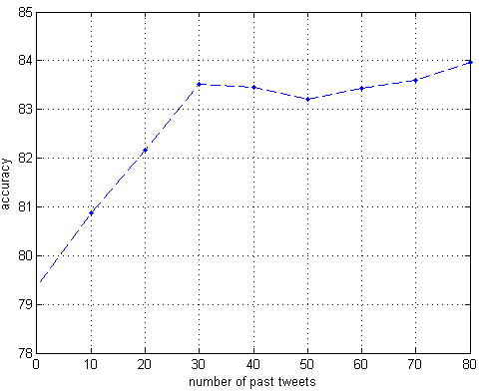
Can historical information improve sarcasm detection?
SCUBA without historical data:
  79.38% accuracy
  Outperforms all other approaches
Historical Data Helps
  4.14% increase in performance.
30 tweets seem sufficient

Slide 19
Which Forms Contribute most to Sarcasm Detection
Feature set | Accuracy
All feature sets | 83.46%
- Contrast-based features | 57.34%
- Complexity-based features | 73.00%
- Emotion expression-based features | 71.52%
- Familiarity-based features | 73.67%
- Written expression-based features | 76.72%
Notes:
- here means remove

Slide 20
What Features Contribute Most to Sarcasm Detection
Percentage of emoticons and adjectives in a tweet
Percentage of past words with sentiment score 2,3,-3
Number of polysyllables per word in a tweet
Lexical density of a tweet
Number of past sarcastic tweets posted
Percentage of positive to negative sentiment transitions made by a user
Percentage of capitalized hashtags in a tweet

Slide 21
Summary
A behavioral Modeling framework of identifying different forms of online sarcasm as:
  a contrast of sentiments
  a complex form of expression
  a means of conveying emotion
  a function of familiarity, and
  a form of written expression
Modeled on Twitter to build a supervised learning algorithm to detect sarcastic tweets
Experiments demonstrate that SCUBA is effective in detecting sarcastic tweets
Notes:
Even limited amount of historical data helps in sarcasm detection

Slide 22
Future Work
How does a user’s social network influences her propensity to use sarcasm?
Does the strength of social ties matter in generating sarcasm?
Can SCUBA be extended to other social networking sites?

