Slide 1
Understanding User Migration Patterns in Social Media
Authors: Shamanth Kumar, Reza Zafarani, and Huan Liu
Published at AAAI 2011
How and Where are people migrating to?
Motivation
Migration is inevitable
Users are primary source of revenue
New sites need to attract users, old sites need to
retain users
Migration can be of two kinds
Site migration
Attention migration

Slide 2
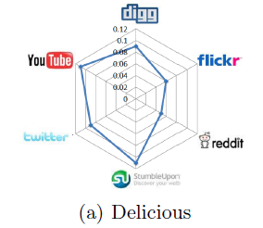
Our Findings
Attention Migration
Occurs when a user becomes inactive
on a site
Can be studied through user activity
to prevent permanent migration
Contributions
Longitudinal study across 3 months on 7 social media sites.
One of the first studies on user migration in social media
Established migration patterns between social
media sites
Validated patterns via hypothesis testing.
Demonstrated that these patterns can be
capitalized by tracking High Net-Worth
Individuals (HNWI)
Site 2
Site 3
Site 1
Site 2
Site 3
Site 1
After time t

Slide 3
Validating User Migration Patterns in Social Media
Problem:
Migration is inevitable
What are the migration patterns in social media?
How do we distinguish observed migration patterns from random patterns?
Evaluation Strategy:
Generate Shuffled datasets by randomly picking users from at-risk population
Compare trends in the observed and shuffled datasets
Shuffled datasets
Coefficients of user attributes
Logistic Regression
Chi Square Statistic
Significance Test
Observed migration dataset
Coefficients of user attributes
Logistic Regression

